Slide 1
Standards-Based Grading
From a Google Trends Viewpoint
By: Alyssa Weber

Slide 2
Objectives:
When did conversations around standards-based grading begin?
Where was standards-based grading first introduced?
Which states are currently using standards-based grading?
How does standards-based grading impact outcomes?

Slide 3
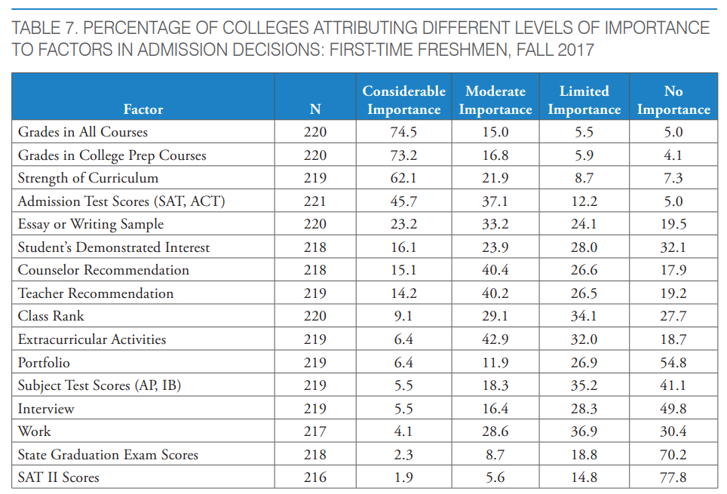
Pros and Cons of Traditional Grading
PROS (Hobden, 2021):
Recognizable
Simple
Streamlined
Clear pass/fail cutoff
Top factor for college admissions (Clinedinst, 2019)
CONS:
Can include inputs that do not impact what a student knows and can do. For example:
Penalties for timeliness
Non-content related artifacts
Implicit biases
(Clinedinst, 2019)

Slide 4
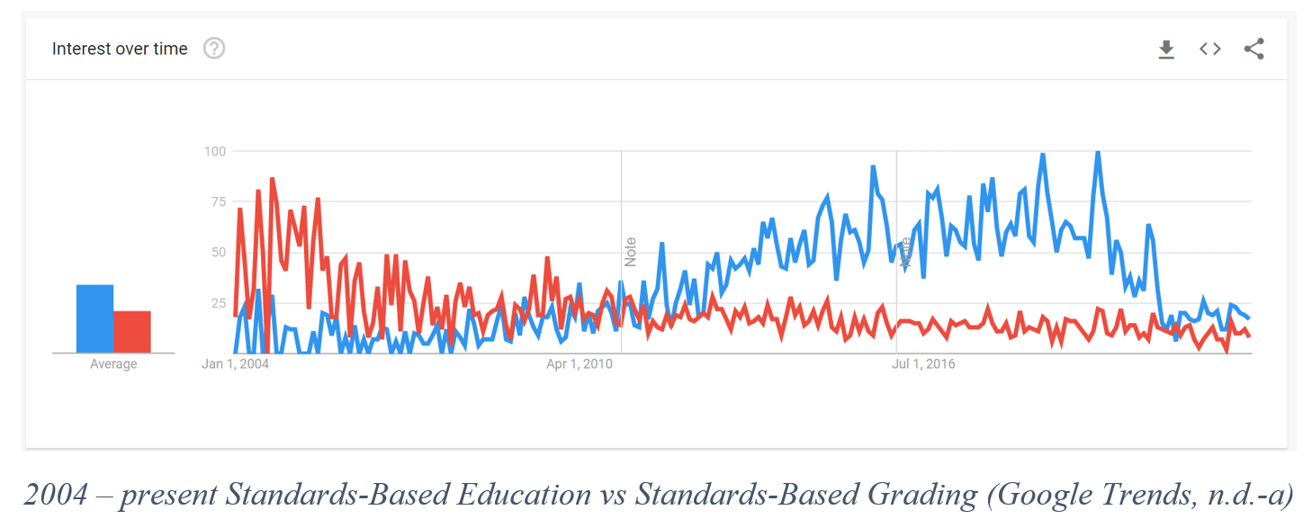
Origin
Education reform surrounding standards began in the 1980’s (Kannapel, 2000). Google trends does not have data to support that far back, but it does show that even up until 2004, standards-based education, in red, was a topic of interest. In 2011, google trends shows a switch in searches to standards-based grading in blue.

Slide 5
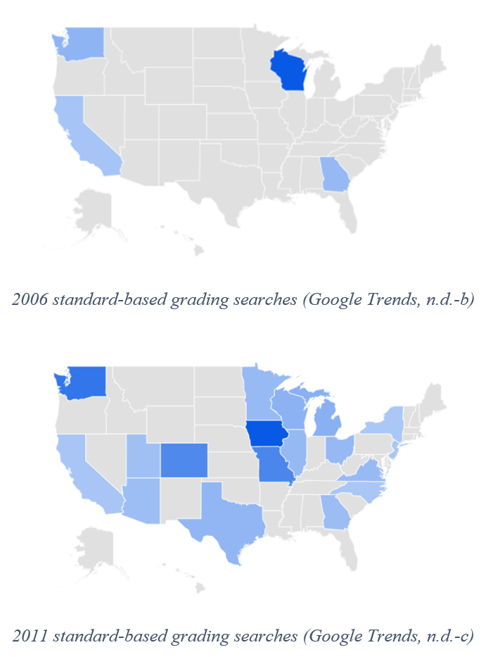
Analysis – First States
Based on the earliest available google trend data, Wisconsin was the most curious in their searches regarding standards-based grading. Within five years the number of states with substantial search data for standards-based grading more than quadrupled.
During this time, related search queries also switched from “what is standards-based grading?” (Google trends, n.d.-c), to more specifics about the 1- 4 grading scale (Google trends, n.d.-d).
This implies that there was a shift from curiosity to implementation.

Slide 6
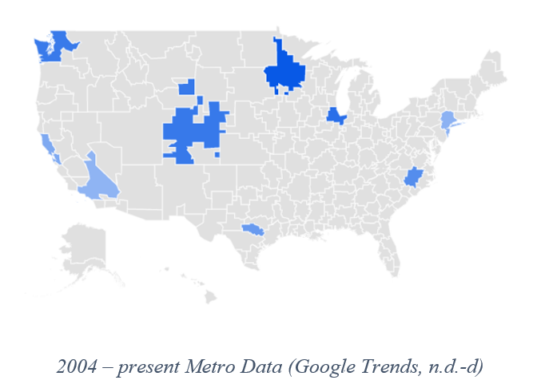
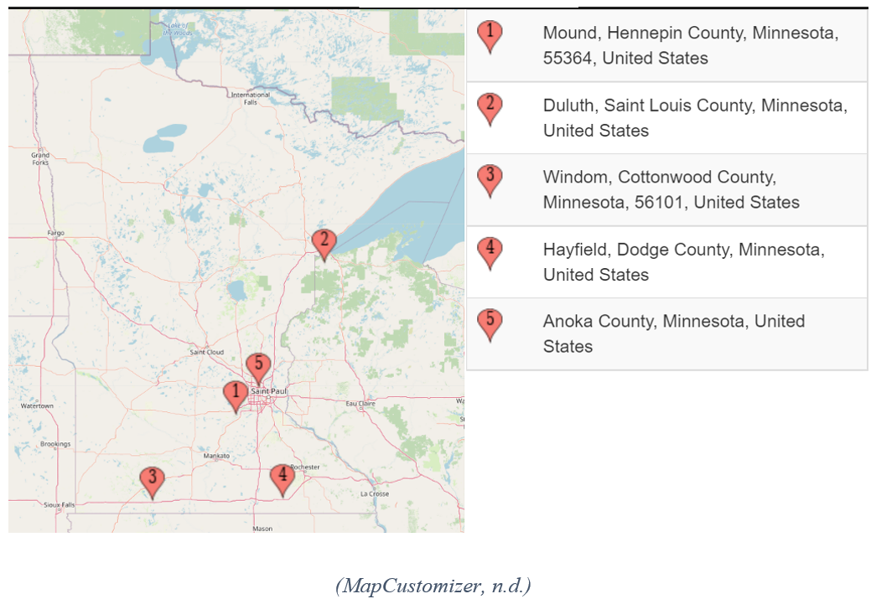
Analysis – MN
In the metro category, Minneapolis-St. Paul, where I am from, has the highest all time search rate for standards-based grading.
This confirms that my area is in fact having conversations about this practice.
To zoom in on the twin cities metro, I googled “Standards Based Grading Minnesota” and mapped out the first five listings. This small sampling matches Minnesota’s blue area from Google trends (other than Duluth).
Surprisingly, the first 5 listings were a mix of both rural and suburban cities.

Slide 7
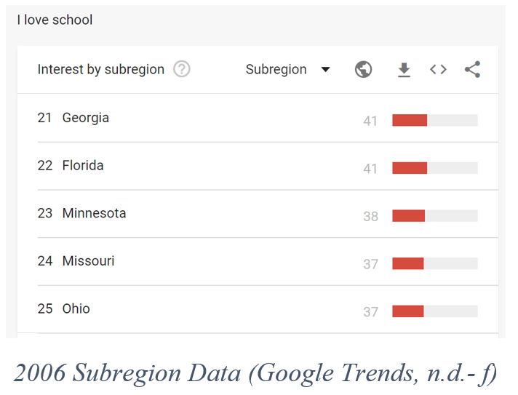
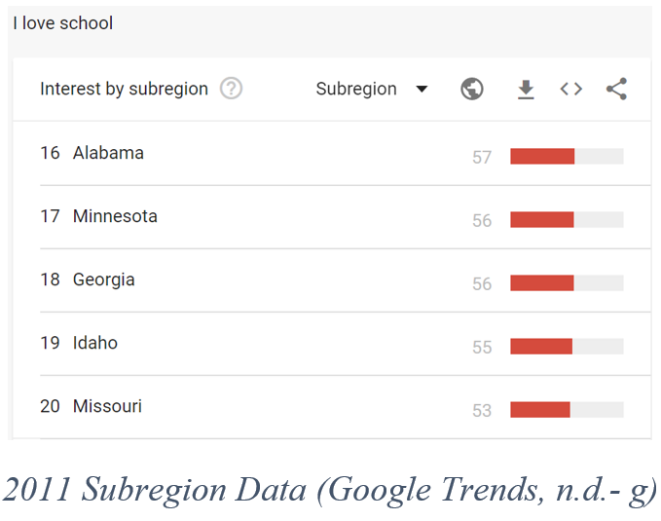
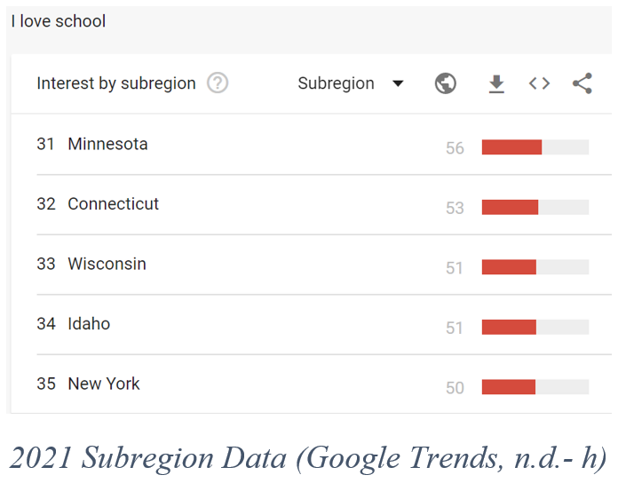
Analysis – “I love school”
Search results for standards-based grading rose in Minnesota from 2006 to 2011. I looked up the query “I love school” and saw that compared to other states, people in Minnesota were searching for this phrase more in 2011 than in 2006. In 2021, the “I love school” search compared to other states dropped significantly to the 31st ranking.
It is important to note that the proportion held steady at 56% (compared to the highest searching state). This means that if we can draw correlation to searching “I love school” and in fact liking school, Minnesota did not like school less in this time, other schools just grew in their love more.

Slide 8
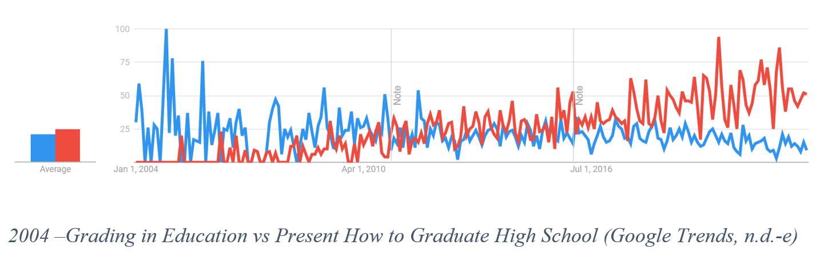
Analysis – Graduation Rates
I also used Google Trends to look up how often people searched for “What do you need to graduate high school?” shown in red. A related query for this topic was “grading in education,” shown in blue.
There was another switch around the 2011 timeframe. This time though, it seems counterintuitive. In 2004, people were searching for standards-based education, but searches about how to graduate high school were low. In 2019 the searches for standards-based grading were rising and so was clarification on how to graduate high school.

Slide 9
Conclusion
Standards-based related searches have been present for more time than I had originally predicted. From the conversations that I am a part of as a teacher, it sounds like standards-based grading is in my near future. It is no longer surprising that district I work for is pushing for changes, seeing that the Twin Cities metro is one of the areas most interested in this topic. Minnesota’s love for school is not dwindling while these conversations are happening, but the impacts are still unknown. I hope to see increased student experience, better defined grades, and increased rigor because of these changes, but we will need to wait more time until Google is able to show us signs of successes.

Slide 10
References
Clinedinst, M. (2019). State of college admission. The State of College Admission Report. Retrieved July 3, 2022, from https://www.nacacnet.org/globalassets/documents/publications/research/2018_soca/soca2019_all.pdf
Google. (n.d.-a). [Google Trends Comparison of Standards-based Grading vs Standards-based Education all time]. Retrieved June 12, 2022, from https://trends.google.com/trends/explore?date=all&geo=US&q=Standards%20Based%20Grading,Standards%20Based%20Education
Google. (n.d.-b). [Google Trends Standards-based Grading 2006]. Retrieved June 12, 2022, from https://trends.google.com/trends/explore?date=2006-01-01%202006-12-31&geo=US&q=Standards%20Based%20Grading,Standards%20Based%20Education

Slide 11
References, cont.
Google. (n.d.-c). [Google Trends Standards-based Grading 2006]. Retrieved June 12, 2022, from https://trends.google.com/trends/explore?date=2011-01-01%202011-12-31&geo=US&q=Standards%20Based%20Grading,Standards%20Based%20Education
Google. (n.d.-d). [Google Trends Standards-based Grading 2021]. Retrieved June 12, 2022, from https://trends.google.com/trends/explore?date=2021-01-01%202021-12-31&geo=US&q=Standards%20Based%20Grading,Standards%20Based%20Education
Google. (n.d.-e). [Google Trends Grading in Education vs How Do You Graduate High School All-Time]. Retrieved June 12, 2022, from https://trends.google.com/trends/explore?date=all&geo=US&q=grading%20in%20education,What%20do%20you%20need%20to%20graduate%20high%20school

Slide 12
References, cont.
Google. (n.d.-f). [Google Trends “I love school” 2006]. Retrieved July 24, 2022, from https://trends.google.com/trends/explore?date=2006-01-01%202006-12-31&geo=US&q=I%20hate%20school,I%20love%20school
Google. (n.d.-g). [Google Trends “I love school” 2011]. Retrieved July 24, 2022, from https://trends.google.com/trends/explore?date=2011-01-01%202011-12-31&geo=US&q=I%20hate%20school,I%20love%20school
Google. (n.d.-h). [Google Trends “I love school” 2011]. Retrieved July 24, 2022, from https://trends.google.com/trends/explore?date=2021-01-01%202021-12-31&geo=US&q=I%20hate%20school,I%20love%20school

Slide 13
References, cont.
Hobden, H. (2021, February 4). Traditional grading scale: Pros, cons & alternatives. School Safety Platform - Kidio. Retrieved July 3, 2022, from https://kid.io/traditional-grading-scale-pros-cons-alternatives/
Kannapolis, P. J. (2000). Standards-Based Reform and Rural School Improvement: Finding the Middle Ground. Journal of Research in Rural Education, 16. Retrieved June 12, 2022, from https://jrre.psu.edu/sites/default/files/2019-08/16-3_5.pdf.
MapCustomizer (n.d) [Standard-based grading schools: Mapcustomizer.com: Plot multiple locations on Google Maps. Create a map.] Retrieved July 3, 2022, from https://www.mapcustomizer.com/map/Standard-Based%20Grading%20Schools

